Slide 1
CCW0604 – Getting Started with ServiceNow Automated Testing Framework
Shrity Verma
Sr. Product Manager
ServiceNow
Joel Fischer
Lead Developer
ServiceNow

Slide 2
Agenda
Overview
Wrap up
Setup
Create Test using the UI
Create Test using scripts
Schedule Test

Slide 3

Speaker Introduction
NAME: Shrity Verma
TITLE: Sr. Product Manager
FUNCTION: Product Management
COMPANY: ServiceNow
EXPERIENCE:
EXPERTISE:
ACHIEVEMENTS:
CURRENT PROJECTS:

Slide 4
Speaker Introduction
NAME: Jane/John Doe
TITLE: Architect/Manager/Director/VP/CxO
FUNCTION: Development
COMPANY: ServiceNow
EXPERIENCE: X years in function1, Y years in function2
EXPERTISE: DevOps, Compliance, Devices, Analytics, Security
ACHIEVEMENTS: Completed first overhaul of deployment process. Reduced customer service response time by x%. Developed ServiceNow app that does …
CURRENT PROJECTS: Driving process efficiencies. Automating all procurements/HR work streams
Notes:
Note: Please use one slide per presenter.

Slide 5
What You Will Learn
1
2
3
HOW TO
CREATE AND RUN
ATF TESTS
FAMILIARITY WITH
NEW FEATURES
HOW TO
SCHEDULE
ATF TESTS
Notes:
Note: Highlight why the audience should care to sit through your session.

Slide 6
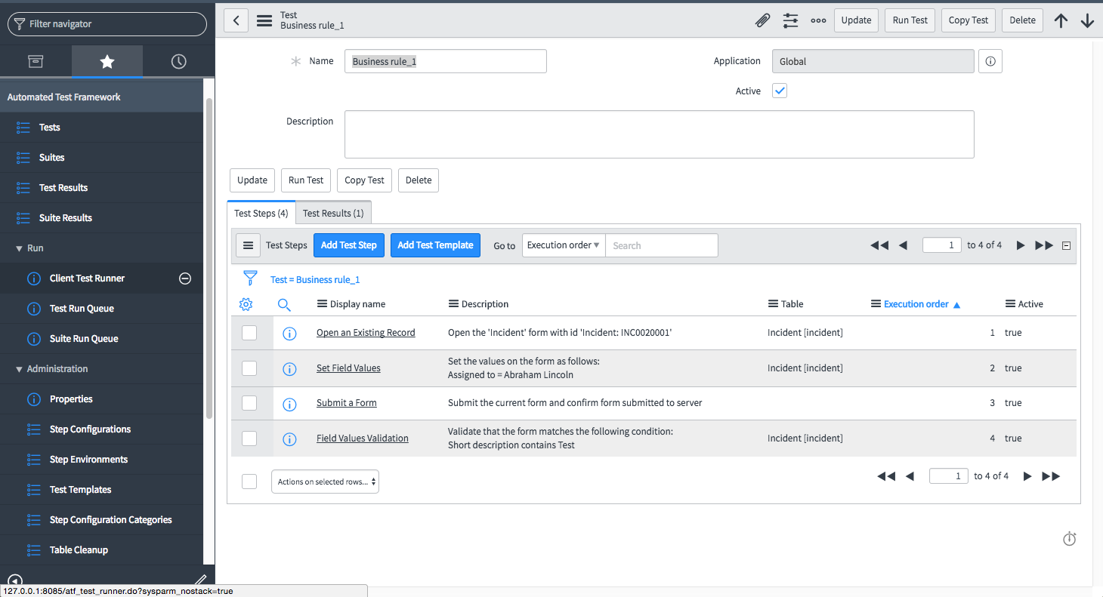
Automated Testing Framework overview
A framework for creating custom automated tests to validate continued functionality after upgrading an instance
Goals
Framework to automate most of the manual tests
Make the tests UI independent
Features
OOB Client Side, Server Side, Service Catalog, Service Portal and REST tests
Can add custom server side and REST APIs steps, and run server side scripts
Test cases rollbacks the records created during the test
Captures screenshots with retention policies
Productivity
Creates automated tests, templates and test suites
Reduces upgrade cycle time
Reduces need for manual testing
Tests not tied to UI making them reusable with future releases
Notes:
Test standard platform forms for proper functionality: Automate the opening a form, disabling a form, set values on fields, enter data, validate specific fields and submit a form.
Drives a browser to test forms
Captures screenshots
Runs client side scripts.
Waits for asynchronous effects like client rules and resolving references
Create retention policies for set policies on specific tests
Insert or update records
Run server side script

Slide 7
What we plan to do in next 2hrs
Create and run test with impersonation
Trouble shoot failed test
How to test a Service Catalog
How to test Left Navigator
What to do when you encounter client side Java script error
Test a business rule
Create your own server side test step
Create test using scripts
Schedule test 10min

Slide 8
Instance Setup and Registration
Prepackaged App installed on the instance
Notes:
Switch to your demo or the workshop guidebook here

Slide 9
Lab 1: How to create simple test
Exercise:
Create a testcase to test opening of Media Library Form by user able tuter works
Run the rest
Result
The test should pass
Notes:
Switch to your demo or the workshop guidebook here

Slide 10
Lab 2: How to analyze failed test
Exercise:
Create a test case to test opening of Media Library Form by user able tuter works
Add a failure step
Run the rest
Result
The test should fail
Go to test result to view the failure
Notes:
Switch to your demo or the workshop guidebook here

Slide 11
Lab 3: How to test a service catalog
Exercise:
Create a testcase which search and order catalog item from media library
Add steps for approval
Run the rest
Result:
The test should pass
Notes:
Switch to your demo or the workshop guidebook here

Slide 12
Lab 4: How to test Left Navigator
Exercise:
Create a testcase which check for Menu items
Create new module
Add a step to test existence of new module
Run the rest
Result:
The test should pass
Notes:
Switch to your demo or the workshop guidebook here

Slide 13
Lab 5: What to do when you encounter client-side JavaScript error
Exercise:
Enable a client script that has java script error
Run the test created in Lab 1
Test should fail – add to whitelist file
Run the rest
Result:
The test should pass with warning
Notes:
Switch to your demo or the workshop guidebook here

Slide 14
Lab 5: Test a workflow
Exercise:
Create test to test pre existing workflow
Result:
Notes:
Switch to your demo or the workshop guidebook here

Slide 15
Lab 5: Create new test step
Exercise:
Add a new test step which does x
Create test using new test step
Result:
The test should pass with warning
Notes:
Switch to your demo or the workshop guidebook here

Slide 16
Lab 5: Create test using scripts
Exercise:
Add a server side test step testing
Result:
The test should pass with warning
Notes:
Switch to your demo or the workshop guidebook here

Slide 17
Lab 5: Create test using scripts
Exercise:
Add all the test in new test suite
Schedule the test suite
Result:
The test should pass with warning
Notes:
Switch to your demo or the workshop guidebook here

Slide 18
Top Takeaways
1
2
3
ATF CAN BE CUSTOMIZED BY CREATING NEW STEPS
ATF TESTS CAN BE CREATED USING SERVER SIDE SCRIPTS
ATF TESTS CAN BE SCHEDULED
Notes:
Note: Highlight why the audience should care to sit through your session.

Slide 19

Thank You
Shrity Verma
Sr. Product Manager
ServiceNow
Shrity.Verma@servicenow.com
Joel Fischer
Lead Developer
ServiceNow
joel.fischer@servicenow.com

